Slide 1

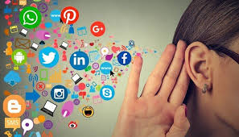
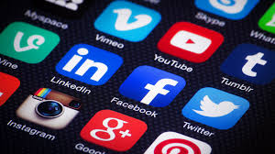
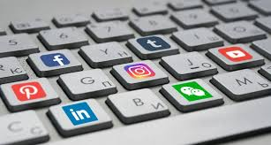
The Social Dilemma- social media giants and adverse effects.
Presented By;
Muhammad Umer
M. Ahmed Mohsin
Zafar Azhar
Tariq Umer

Slide 2

Things we will talk about
Who are the Social Media Giants and what purpose do they serve on surface versus reality?
Short and long term effects of social media
How we’re actually a product rather than a customer?
Data – new running money
Data manipulation
Privacy invasion and stalking
How is social media changing the way we think?
What do we do?

Slide 3
Social media and tech giants
By the term tech giants we usually refer to Facebook, Amazon, Google, Microsoft, etc. These companies have grown tremendously in the recent years, much that the world’s economy revolves around them
Engagement
Interaction
On the surface, it may seem like that such platforms are developed so societies can remain connected and up-to-date with their surroundings, and it, indeed, serves such purposes solidly.
However, it is naïve of a layman to think that such companies work solely for the benefit of humanity.
In reality, what they’re actually after is engagement. Your engagement.
Data
Profit

Slide 4
Evolution of Social Media
Social media began with a series of electronic dots and dashes tapped out by hand on a telegraph machine..
1884
1969
Modern origins of today’s internet and social media point to the emerged in.
The direct precursor to today’s internet came into being
1987
2001
Introduced users to digital communication through email, bulletin board messaging, and real-time online chatting.
2002
LinkedIn was founded as a networking site. By 2020, it had grown to more than 675 million users worldwide.
Facebook
Twitter
Instagram
Snapchat
Tiktok
2004
onwards
As of today, there are 3.81 billion people actively using social media in the world and trillions of GB data access to all these apps

Slide 5
Effects of social media
Social media is, without a doubt, a revolutionary invention of humanity. People can stay in-touch with their relatives, have a platform to show their talents and creativity and it promotes civic engagement.
However, the problems that arise due to its usage are far more damaging than what its benefits can make up for. Few such problems are:
Wastage of Productive Time
Addiction
Privacy Invasion / Cyber-Stalking
Behavioral Changes
Selling out of data
Fake News
Alters
the way we think
Unpredictable changes in behavior
Data shared with everyone
Distracts the new and emerging youth
Reduced
real social interaction
Political and Social Disparity

Slide 6
How are these Social media Giants using us?
Ever wondered that how these media giants like Google, Facebook, Apple, Amazon etc do business? Their customers are the advertisers, NOT US!
We are actually the product that is being exchanged between them.
The companies pay google to change our mindsets and bring the world their course by small increments and they will pay google for this task.
Google will then, utilize its potent algorithms to cause a slight unpredictable change in our thinking and that is the product.
These social media apps are capable of manipulating us the way they like.
It is rightly said by Carole Cadwaladr and I quote: “If Facebook were to be a country, it would be North Korea.”

Slide 7
Our behavior predictions are being interpreted by our former data and are then sold to advertisers! There exists a field called data science related to it.
Data plays a huge role in understanding valuable insights about target demographics and customer preferences. Data is important to them as the running money! Once oil was known as running money but as time passed data took over everything and is considered as the fuel of modern economy. The most important thing about data is that it has the virtue of being in state of constant growth. The advertising companies along with companies, who need to sell their products to us, invests huge amounts to gather data of users which helps them to predict the growing trends accurately and target us as per our interests.
It is study that combines domain expertise, programming skills, and knowledge of mathematics and statistics to extract meaningful insights from data.
Why is this data Important to them?

Slide 8
Privacy Invasion and Stalking
Have you noticed how some of the ads on the sites you visit seem to be a perfect match to your interests?
Think that’s a coincidence?
The software companies running the social applications thought promise to keep our data secure but actually they keep an eye on us, compile the data and sale it for further use.
Cookies - small files stored on a computer that enable tracking the user across different sites. They are claimed to be secured but actually these files are the one which let advertisers target us.
NO!
DAILY LIFE EXAMPLE

Slide 9
That database is shared worldwide as per contracts with the companies and our preferences and likings stay no more personal
The information is stored in a file called cookie
That file along with our identity and information is updated to software’s database
In the end they earn money and our data is sold worldwide
We perform certain activity on internet e.g. searching
Our devices have been replaced with sensitive sensors that regulate our activities all day around. We can not control storing data, we cannot access stored data, we cannot monitor it, in environments where our rights are rendered meaningless.
And companies claim that, this helps them to 'Understand their Customer” so that they can better tailor their efforts.

Slide 10
How we are being affected
People lose sight of what’s true and what’s false. They do not bother doing further research to check the credibility of the source.
Inadequacy about our life or appearance.
Algorithms also learn our personality and psychology and change it
Prioritizing online interaction over in-person relationships
Cyber bullying

Slide 11
What do we do?

Slide 12
Are Tech companies going to accept that aforementioned problems are because of them?
NO!
This is their way of business and all the authorities together are getting share from the earning.

Slide 13

Tech Industry employees keep their children away from Social Media until high school.
This implies, that we have to take steps on an individual scale to minimize such problems.

Slide 14
1. Stop watching the videos recommended to you by the apps. Always search by yourselves, if you want to watch something. 2. Then we should have family rules defining how much of screen time one may have each day. 3. Keep electronic devices out of bed rooms.
Reduce our screen time!
BUT HOW?

Slide 15
1. Double Check any news before believing/sharing any news. 2. Before promoting anything, make yourself aware of the consequences. 3. Avoid debating on sensitive issue on social platforms!
FAKE NEWS / HATE SPEECH!

Slide 16
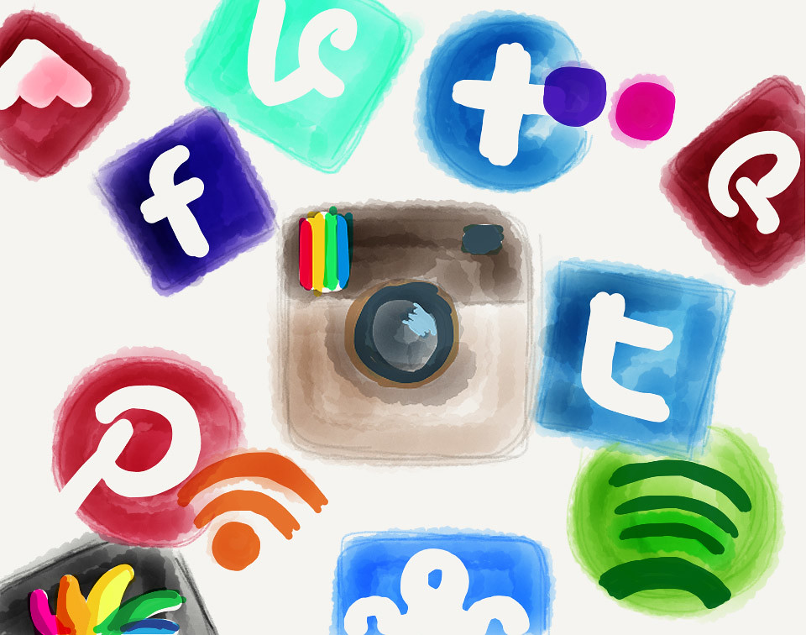
Other Ways
Unfortunately, you cannot control stalking but can turn off cookies, you can control how much information about yourself you put out there. So, modify your privacy settings.
Limit usage of social networking sites to personal use only. Do not write about work issues. Always assume everyone in the world will be able to see what you’re writing even if the site limits your post to your friends exclusively. And remember that the internet never forgets, especially with things like screenshots.

Slide 17
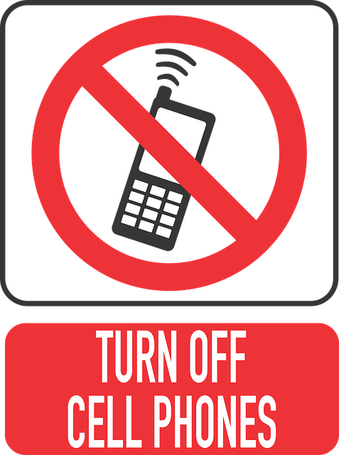
MOST IMPORTANT!
Turn off notifications as they instigate you to check your phone or the social site.
The thing is if we examine the content of the notifications, most of that information that notifications dump on us are, well, not important at all.
Less than 1 out of 10 times, they turn out to be a breaking news or urgent family or work matters, while more than 9 out of 10 times they just disrupt what we are doing.
TURN OFF NOTIFICATIONS
In conclusion,
Use Social Media Wisely

Slide 18
THANK YOU

